Slide 1
Legacy to Modern
QT-HOL-3242LV
#TorontoVMUG
GO SABRES!
GO LEAFS GO!!
(haha no)
My VxRail Story
Richard Kenyan
Infrastructure Engineer – CUBRC
I’m not lazy, I’m efficient!
Notes:
Standard welcome…
25 years in the industry
Worked in healthcare, finance, startups, fortune 50, small business
I’ve worked for a series of small companies that did big things, and a few big companies that did specific things.
vExpert / VMUG Leader
Don’t mention ops yet – wait until slide 4 – “I’ll get into my technical background a bit more in a minute”

Slide 2

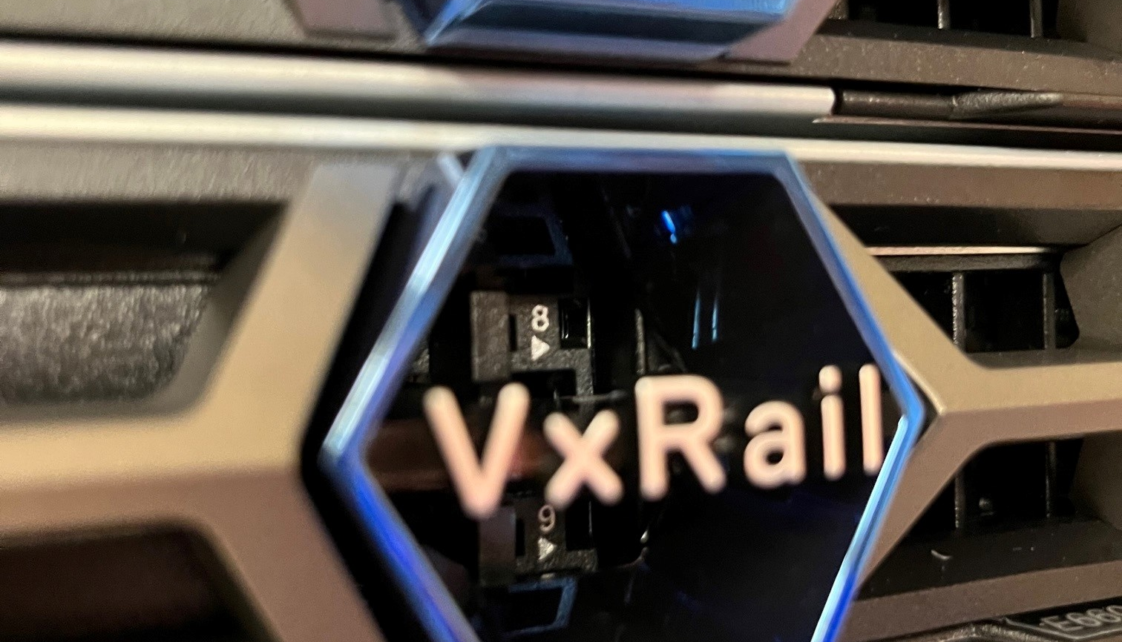

Customer Success – CUBRC
Budget, Flexibility, Scalability, FIPS/Encryption, Physical Space
ABOUT
SOLUTION
CUBRC is a leading Research, Development, Testing, and Systems Integration company specializing in these areas: Data Science & Information Fusion, Chemical, Biological, & Medical Sciences, and Aeronautics.
VxRail E660F nodes – x4 and x3 Dell S5248F-ON – x2 and x2 25Gbps networking 100TB vSAN Storage (ALL FLASH!) 370GHz CPU 4TB RAM
Buffalo, NY
Aerospace
CHALLENGES
IMPACT
Various storage solutions in play
3-Tier not ideal for lifecycle management
Forklift upgrades, disparate vendor hardware support contracts
Multiple infrastructure silos and management tools
Lacking NIST/CMMC FIPS 140-2
vSAN replaces separate SAN/NAS
Ease of day-to-day use
Collapse infrastructure (including networking), future expansion
One interface
NIST/CMMC FIPS 140-2
LEGACY PRODUCTS REPLACED
STRATEGIC PRIORITIES
EMC VNX5200
Customer / Vendor partnership
PowerEdge and R-Series Servers
Dell’s portfolio of solutions
Netgear Pro series networking
Feature flexibility for CUBRC’s needs (Tanzu)
Notes:
Let’s set the stage…slide walk through
2 data centers
mention Dell itself and what it brings to the table
Expansion is easy, just buy n nodes or increase your number of disks/memory.
BEFORE HITTING NEXT ON LAST SLIDE TEXT -> Introduce big reason: “MY BIGGEST REASON THOUGH?” CLICK

Slide 3
Biggest Reason?
TIME
Notes:
TIME / CVEs / Want to stay secure / obvious reasons
NOW background operational work – Telecom/ISP – 9 Datacenters / 300 Hosts / 6000 VMs (5000 prod / 1000 dev)
I didn’t want to do that again, manually.
Then move to the next slide and frame it with the about numbers.

Slide 4
Time Spent
Every CVE represented the following process
Process
Research, HCL, Risk Assessment, Lab Deployment, Test, Wait, Confirm, Prod Deployment
CPU Intel/AMD Hypervisor vCenter VMware Tools
Networking NICs Firmware Drivers Physical Switches
Storage SAN/NAS HBA Drivers Firmware
LOM/OOB
BIOS
EFI Firmware
HCL and research for each
Variables
GuestOS updates GuestOS perf. hits
Bug fixes Release Notes
Support Open internal tickets Open vendor tickets
Multiple vendors Finger-pointing RCA
Cross-vendor matrix Supported versions
Supply chains Hardware failures
Notes:
In my case, CVE patching is very important to me.
HeartBleed/Spectre/Meltdown/Log4j…
Dis-separate hardware, old legacy clusters, replacements on grey market, HCL past versions
Each box on this slide can be a separate talk on its own

Slide 5




Time Saved
A new, simpler update process
One Dell VxRail SKU – You are buying a solution, not a stack
Open Support Request
Dell Health Check
Dell Deploy Schedule
Dell Verifies Solution
One Call
One Product
One Solution
Notes:
VxRail is truly an all-in-one solution.
All release testing is done by Dell, resulting in thousands of hours already run on a /relatively/ limited set of hardware SKUs.
Am I still reading release notes? Sure. But just the VxRail/VMware ones.
Dell patches /CVE fixes/releases have reliable release patterns of 6-8 weeks, so any thing I’m hit by can be planned out beforehand.
MENTION -> MULTIPLE CVEs get patched as your entire solution gets patched…networking/storage/VMware/LOM
CALL DELL – you bought the solution, it comes with support. Don’t do it all yourself. You bought an HCI solution! Utilize the support teams, YOU PAID FOR IT.

Slide 6

Real-World Numbers
Sure, some marketing fluff, but I can corroborate.
Man Hours: Customers have reported that using VxRail has allowed them to grow without having to increase staff because of standardization provided by VxRail. 1
No, really. The VxRail system we deployed has drastically reduced the time I now spend on the care and feeding of my VMware Infrastructure.
Outages: 81% faster to resolve unplanned outages: The same IDC report found that customers who choose Dell VxRail can expect to resolve unplanned outages 81% faster. 2
Operations: 61% lower operational costs: The same IDC report found that customers who choose Dell VxRail can expect 61% lower operational costs. 3
ROI: 463% 5-Year ROI: According to an IDC report, customers who choose Dell VxRail can expect a 463% 5-Year ROI. 4
Notes:
Man Hours – 6 person IT Team – I’m senior/4 SMEs/1 Help Desk
Outage – 1 sort of outage so far – power off due to power circuit work – couldn’t boot up – 1 call to tech support – immediately knew all my info on about system, and what the error code was exactly. Walked me through easy HARDWARE procedure, everything came up. Saturday – at night…. – SAS CABLE DISCONNECTED – 1 hour to fix between call time, crash cart setup, setup and climb ladder, fix, document, tear down ladder, power up, function restored.
Operations – once it was setup, I get CloudIQ reports daily
ROI – couldn’t beat the price – have started to use the platform in ways we hadn’t thought of – lower power usage – *time* to grow is minimal – switches allow passthrough for other solutions (think backups)

Slide 7
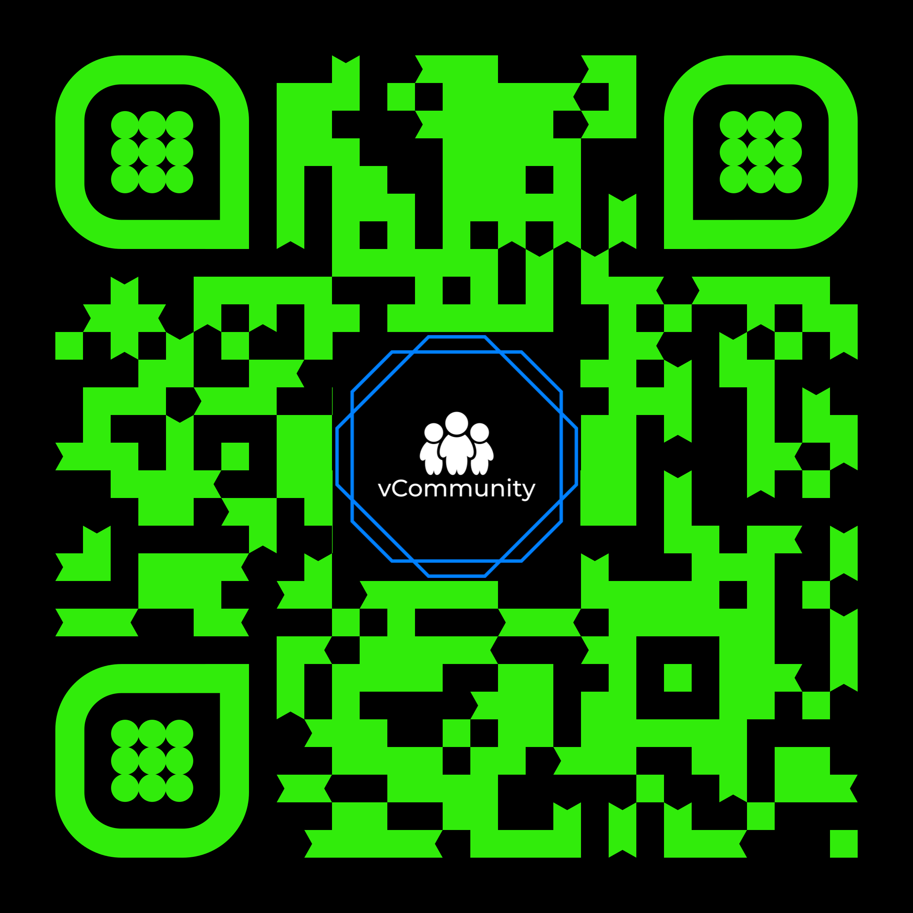
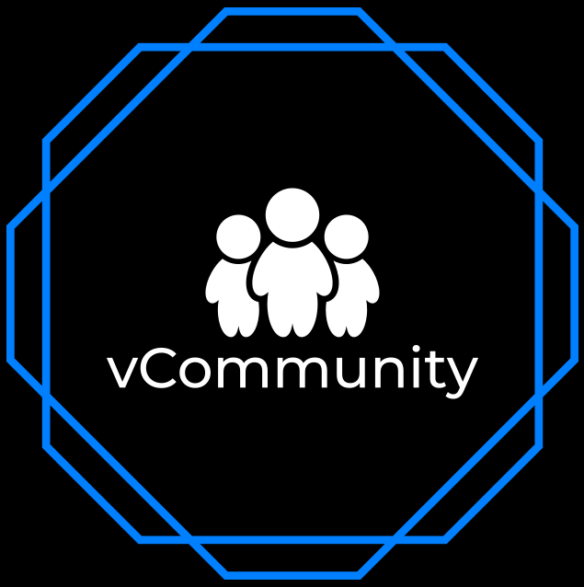
Stay Connected Let’s continue the conversation
Follow @VxRail, #VxRail, @DellStorage_HCI, @RichardKenyan, @ITRealityUS
Dig deeper: Join our vCommunity Discord
Notes:
Multiple topics in our discord
All things VMware and more - OnlyFarms
Industry rooms for security/backups/storage/etc…

Slide 8
Please take your survey.

Slide 9
Thank You

